Slide 1
N-Queens Visualiser
Created by Mebanseibor Lyngdoh

Slide 2

Problem Statement🧩
The n-queens puzzle is the problem of placing n queens on an n x n chessboard such that no two queens attack each other.

Slide 3

Objective🎯
Given an integer n, we must display all distinct solutions to the n-queens puzzle, all done within a single programming language

Slide 4

Terminology📖
Rank
In chess, a rank refers to a straight full set of squares on the horizontal axis
File
In chess, a file refers to a straight full set of squares on the vertical axis
Frame
A frame is a window using by java
Panel
A panel is a section within a frame

Slide 5
About the program💾
Programming Language used
Java
Package(s) used
java.util.Scanner
To take input from the user
java.util.List
To store the answer/results with a list
java.util.ArrayList
To instantiate an abstract list
import java.awt
To create Abstract Window Toolkit import javax.swing.*;
Easy to use GUI components

Slide 6
Flowcharts🔀
Over View
Rendering the Live Preview

Slide 7
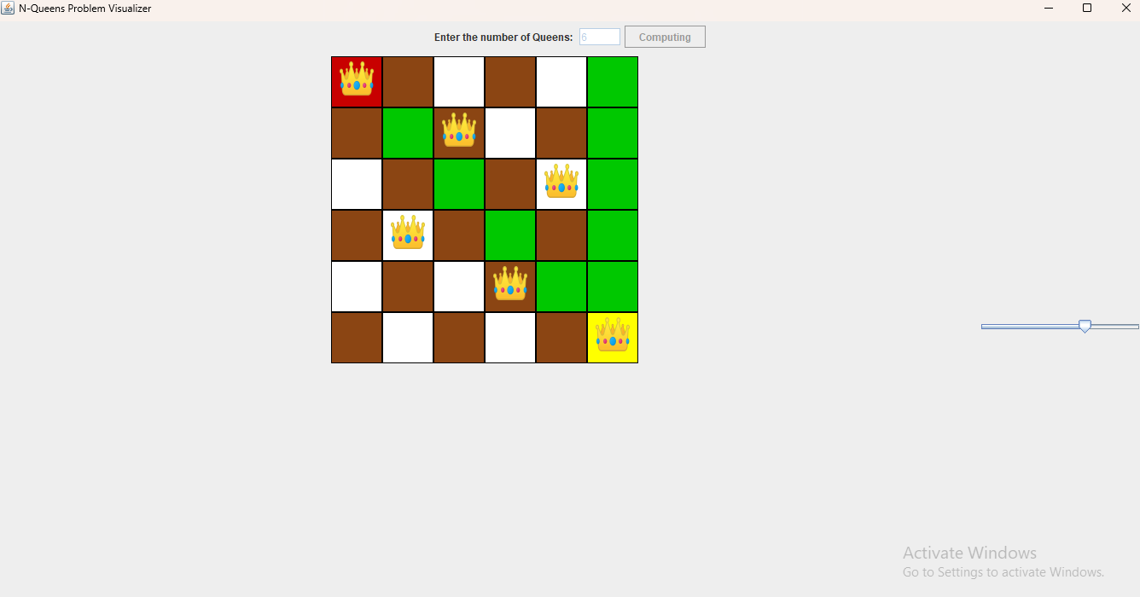
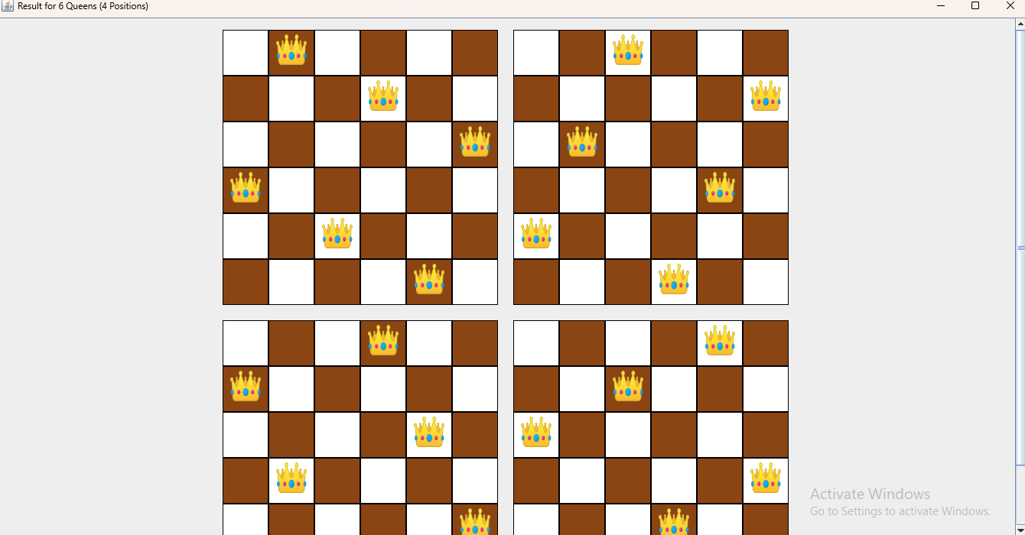
Preview🖼️
Main Window
Result Window

Slide 8
Future Enhancements🔮
Better error handling
Implement error handling when a non-valid integer is entered as the number of queens
Implement error handling for the function buttonCompute.addActionListener()

Slide 9
Development Issues Faced🚩
Stretched out grid when using GridLayout
Cause of the problem
Grid Layout did not respect the panel's preferred size
Solution:
GitHubLink

Slide 10
Things Learnt🎓
Using packages catered for rendering graphical items
Handling threads

Slide 11
Links🔗
GitHub Repository
About the problem:
By LeetCode
Completed project reference:
By GSR
Drawing a chess board in Java:
By GUIProjects

Slide 12
End of Presentation
Thank You

